Slide 1
Report on the Task
Debloating Application Containers via DockerSlim
Amir Andalib

Slide 2
DockerSlim
DockerSlim claims*:
“Don't change anything in your Docker container image and minify it by up to 30x making it secure too! Optimizing images isn't the only thing it can do though. It can also help you understand and author better container images.”
* https://github.com/docker-slim/docker-slim
Amir Andalib Report of the debloating Task Page 1/7

Slide 3
Experience with DockerSlim
We try to slim a web application which comprise 14 docker containers
General Challenges & Findings:
Some of the web applications written in languages such as Python and Ruby, require service interaction to load everything in the application*. → HTTP-Probe Needed!
Some containers fail to run properly even with successful build.
On some containers running HTTP-probe is “failed with the error connection reset by peer”
Can Docker-compose and the containers’ dependencies arise some issues and errors in slimming?
https://github.com/docker-slim/dockerslim#running-containerized
Amir Andalib Report of the debloating Task Page 2/7

Slide 4
Experience with DockerSlim
General Challenges & Findings:
Some Issues that can result in HTTP-probe ERROR:
The webserver of the application points to localhost and not reachable from outside*.
No application is running on the exposed port
Firewall
Other issues that stem from container inner configuration
* https://nickjanetakis.com/blog/docker-tip-54-fixing-connection-reset-by-peer-or-similar-errors
Amir Andalib Report of the debloating Task Page 3/7

Slide 5
Experience with DockerSlim
General Challenges & Findings:
Some Trials to address the problem
Checking the aforementioned problems for every container that has the probe issue
Use a list of exposed ports in provide a list of ports to be probed
Manually make the probe port to be listened
Start services in interactive mode
Exclude necessary paths
Build slim container with docker-compose option.
Amir Andalib Report of the debloating Task Page 4/7

Slide 6
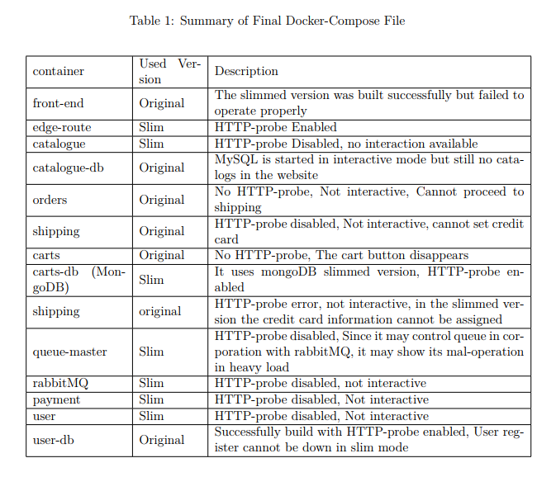
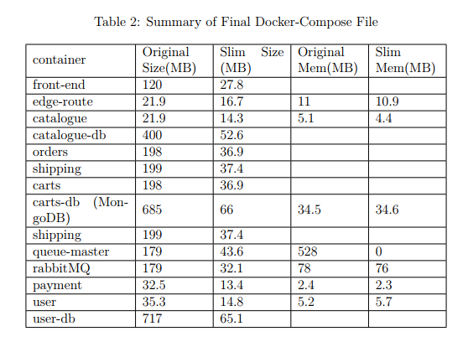
Experience with DockerSlim
Amir Andalib Report of the debloating Task Page 5/7

Slide 7
Experience with DockerSlim
Conclusion:
DockerSlim failed in what it claims at least in debloating containers automatically
It can provide a useful insight about container
It should be adjust manually and be used very carefully
It is not a reliable tool to debloate containers
Removing the bash may result in failure of some bashscripts to run!
Amir Andalib Report of the debloating Task Page 6/7

Slide 8
References
[1] https://github.com/docker-slim/docker-slim
[2] https://github.com/docker-slim/dockerslim#running-containerized
[3] https://nickjanetakis.com/blog/docker-tip-54-fixing-connection-reset-by-peer-or-similar-errors
Thanks for Your Time and Attention
Amir Andalib Report of the debloating Task Page 7/7

